Slide 1
Crypto Decentralize Application
Subham Maity Subhasish Negel
14400119043 14400119044
maitysubham4041@gmail.com negelsubho@gmail.com
Bikram Debnath
14400119018
bikramdebnath706@gmail.com

Slide 2
Abstract
A Bank is a financial institution which receives deposits and grant loans to its stakeholders. Finance is a stream of banking that involves settlement and controls the withdrawal and deposits. When a currency in the form of cash is deposited into a bank, it is taken care of by the finance process. E-wallets become a traditional method of banking these days since we have entered the age of digital banking, with which we can see a number of security loopholes specific to payment gateways, where the hackers steal the money from credit or debit cards by diverting the OTP to themselves. It all starts with a minimum amount, but the impact is bigger when the per transaction amount is increased, by every attempt. The SIM clone is another problem area, which needs to get fixed these days. Using SIM clone, anyone can steal money from a user’s account, if or not you are using online banking. This research paper touches on how effectively the banking system can handle frauds related to transactions by ensuring authenticity with the implementation of the system powered by blockchain. Keywords: Banking, Finance, UPI, Crypto, Blockchain, Crypto wallets, E-wallets.

Slide 3
INTRODUCTION
A blockchain is a growing list of records, called blocks, that are linked using cryptography. Blockchain private and public keys are stored in a cryptocurrency wallet, but not the actual currency values. Wallets provide customers with the ability to send and receive virtual currency / tokens and tune their balance through interaction with blockchains. Multi-currency wallets may be broken down into 3 categories: software, hardware, and paper. Software wallets are web, mobile and desktop. Growing penetration of blockchain in many industries makes one to understand wallets in detail. There are a variety of wallet kinds to pick out from. This paper focuses on multi-currency wallets review exploring on features like supported currencies, anonymity, cost, platform support, key management, wallet recovery methods and fiat currencies supported.

Slide 4
OBJECTIVE
Our main objective is to create dApp designed for
normal users who want to send cryptocurrency to each other through an app, and the process will be extremely
straightforward. Normal people can also perform a large number of tasks
on our web3 platform, which will assist them with
investment tips, help them make investments more
profitable with our artificial intelligence, and offer them
a variety of features.
Using Machine Learning, predict future crypto prices
and know when to sell, reducing the risk for traders.

Slide 5
MOTIVATION
A distributed ledger is a more transparent way of
handling records and transactions due to its shared, immutable nature. Since every record is synced across
the network, a successful cyber-attack is highly unlikely. The Ethereum Blockchain, as a distributed ledger, should be seen as a technology with the potential to
touch and revolutionize every sector of today’s society: from governments to financial institutions. Individuals
could hold and better control their personal information and share these only when they decide to. Governments,
for example, could better track digital property in a
better and efficient way in addition to ensuring no third
party can ever change a record because of censorship or
oppression.

Slide 6
IMPLEMENTATION
Our Crypto dApp is made up of software which contains private and public key and uses blockchain to send and receive currency. The currency in these wallets is added in the form of coins, such as test eath
etc. To trade or send or receive crypto coins or currency, one requires the crypto wallet gets created.
The currency is not stored at one location instead they all exist in the form of transaction records on the blockchain. As these wallets store private and public keys, a user is facilitated with various operations such as to send or receive coins, monitor coin balance, trade the coins on portfolio using the wallet. This also ensures the privacy of the user by using a hexadecimal address of the wallet. However, the address of currency to be exchanged differs from one service provider to
another.

Slide 7
TOOLS
BLOCKCHAIN
• Using Rapid API
• ReactJS
• HTML
• CSS /Tailwind/Bootstrap
• Backend Layer in Web3.0: Solidity Rust Python
Ethereum Blockchain
• Truffle Web3.js JSON-RPC
MACHINE LEARNING
• Pandas
• Pandas Datareader
• Yahoo Finance
• Facebook Prophet
• Plotly
• Steamlit

Slide 8
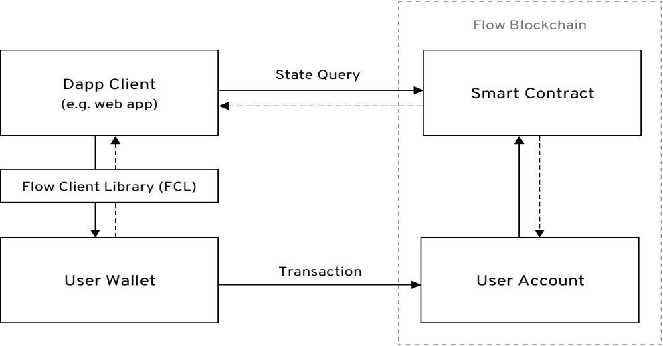
FLOWCHART
Frontend Using : RapidAPI, ReactJS, JS, HTML, CSS/Tailwind
Backend Using : Solidity, JS: Api call using Coin Ranking Api, Paw Deployed on: GitHub Pages, Netlify,
Heroku
Prediction Using Loading the packages
& dependencies
Dataset analysis: Model creation
Visualization Predicted Data :Deploy on StreamLit

Slide 9
METHODOLOGY
The development process of dApp is different from the centralized ones.
1. List the app requirements and check them for their feasibility.
2. Install the Node Package Manager.
3. Choose your tech stack, including database, frameworks, hosting, frontend, its contracts, programming language, APIs, and development server. You can use Ethereum for the same.
4. Launch an Initial Coin Offering to raise the funds that you will need to develop your project.
5. Build your dApp using the platforms like truffle.
6. Test your dApp and smart contract for its functionality.
7. Once tested successfully, you can launch the dApp

Slide 10
CONCLUSION
The adoption of technology depends on the requirements of the business here in the case is for the payment system. The no of profits margin derives from the adoption of technology. Most Banks around the globe have adopted blockchain as they value customers’ privacy in the first place. There are always pros and
cons related to each technology which goes the same in the case of blockchain too. They only problem with technology is the cost. The cost drives the business day to day operations, so this is where the banks have to think carefully before adoption this technology. The blockchain-based payment system becomes more
temper proof when it is powered by blockchain.

